Slide 1

Stability Analysis of Deep Neural Dynamical Systems
LEAC, 18th of May 2021
Ján Drgoňa, Elliott Skomski, Soumya Vasisht,
Aaron Tuor, and Draguna Vrabie

Slide 2
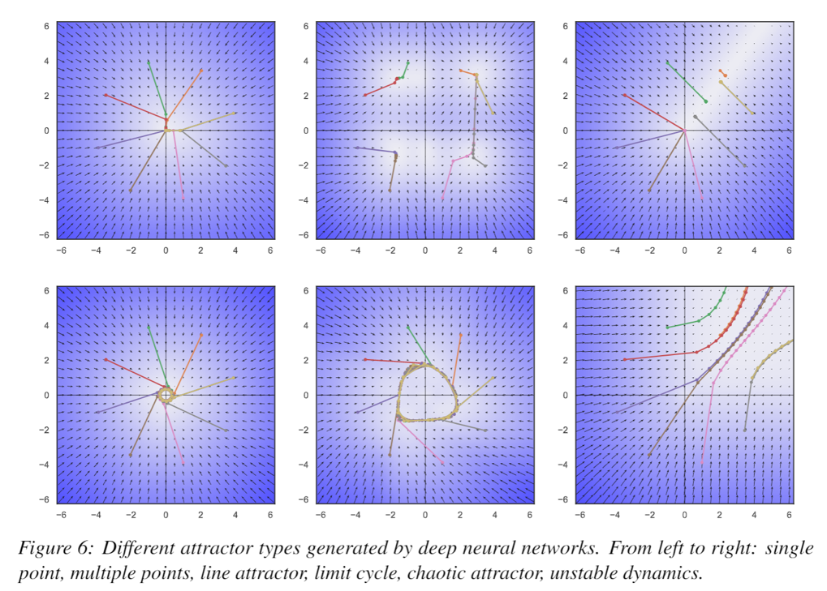
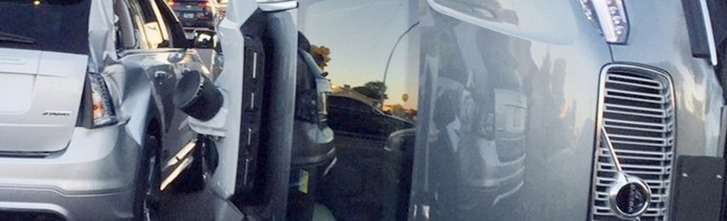
Stability Analysis of Deep Neural Networks
Motivation
Safety-critical and high-performance systems call for formal verification methods to guarantee safe operation.
Objectives
Stability guarantees for deep neural networks.
Approaches
Apply control-theoretic analysis methods on DNNs.

Slide 3
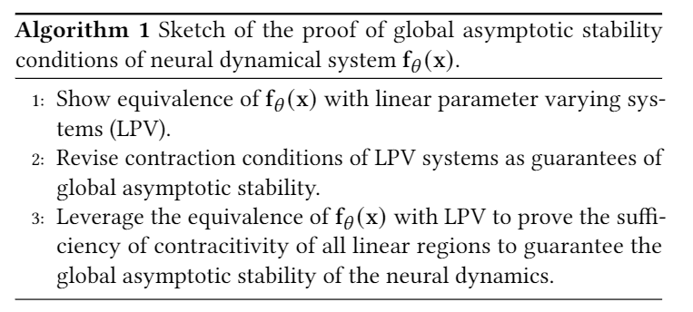
Global Asymptotic Stability of Neural Dynamics
Notes:
The presentation I’m giving today is for a data-driven method for dynamics modeling.
We should care about this because people interact with and depend on complicated systems all the time.
Greater understanding of these systems can lead to outcomes which are
More energy efficient
Cost effective
Conducive to human life
Having an accurate model of a system enables scientific discovery,
Can provide critical information to support high stakes decisions in changing environments
Or to provide necessary information for predictive maintenance of high value equipment, avoiding costly and potentially dangerous equipment
Failures.
One of the most common and lucrative uses of systems models are for predictive control in manufacturing and other large scale enterprises.
I’m presenting a method today which bridges benefits of traditional physics-based modeling with more recent data-driven modeling using deep learning
Traditional physics-based modeling works very well and is widely used in many real world applications. However, it can’t always be applied to every situation.
missing information
incomplete awareness of the model state space.
limitations on the available operational data.
For large scale systems, not only are they difficult to model from first principles, it is also not always possible to simulate the system in real time.
Data-driven approaches for systems modeling are an alternative in these situations but can come with their own disadvantages.
Can take a lot of data to train and may behave unpredictably outside the distribution of training data in unobserved regions of the system state space.
In addition, modern neural network approaches don’t typically provide constraints enforcement within physically realizable and operationally safe bounds,

Slide 4
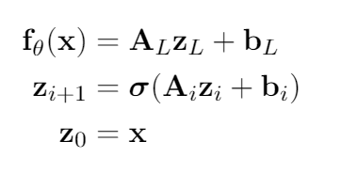
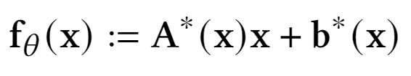

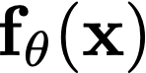


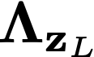
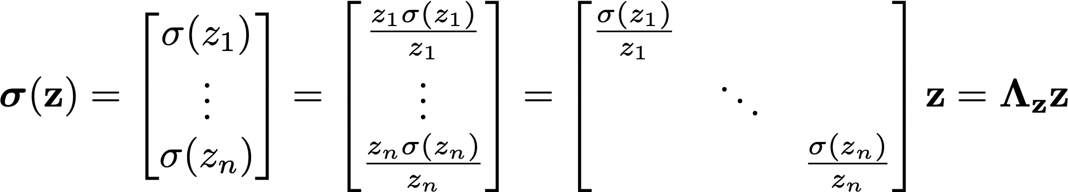
Deep Neural Networks as Parameter Varying Affine Maps
Deep feedforward neural network
Parameter varying affine map
At every point , the neural network, without bias may be represented as
where represent the weight parameterizations at layer , and is a diagonal matrix that represents the element-wise application of the nonlinear activation function at layer .
Jan Drgona, Aaron Tuor, Soumya Vasisht, Elliott Skomski, Draguna Vrabie, Spectral Analysis and Stability of Deep Neural Dynamics, arXiv:2011.13492
Notes:
The presentation I’m giving today is for a data-driven method for dynamics modeling.
We should care about this because people interact with and depend on complicated systems all the time.
Greater understanding of these systems can lead to outcomes which are
More energy efficient
Cost effective
Conducive to human life
Having an accurate model of a system enables scientific discovery,
Can provide critical information to support high stakes decisions in changing environments
Or to provide necessary information for predictive maintenance of high value equipment, avoiding costly and potentially dangerous equipment
Failures.
One of the most common and lucrative uses of systems models are for predictive control in manufacturing and other large scale enterprises.
I’m presenting a method today which bridges benefits of traditional physics-based modeling with more recent data-driven modeling using deep learning
Traditional physics-based modeling works very well and is widely used in many real world applications. However, it can’t always be applied to every situation.
missing information
incomplete awareness of the model state space.
limitations on the available operational data.
For large scale systems, not only are they difficult to model from first principles, it is also not always possible to simulate the system in real time.
Data-driven approaches for systems modeling are an alternative in these situations but can come with their own disadvantages.
Can take a lot of data to train and may behave unpredictably outside the distribution of training data in unobserved regions of the system state space.
In addition, modern neural network approaches don’t typically provide constraints enforcement within physically realizable and operationally safe bounds,

Slide 5
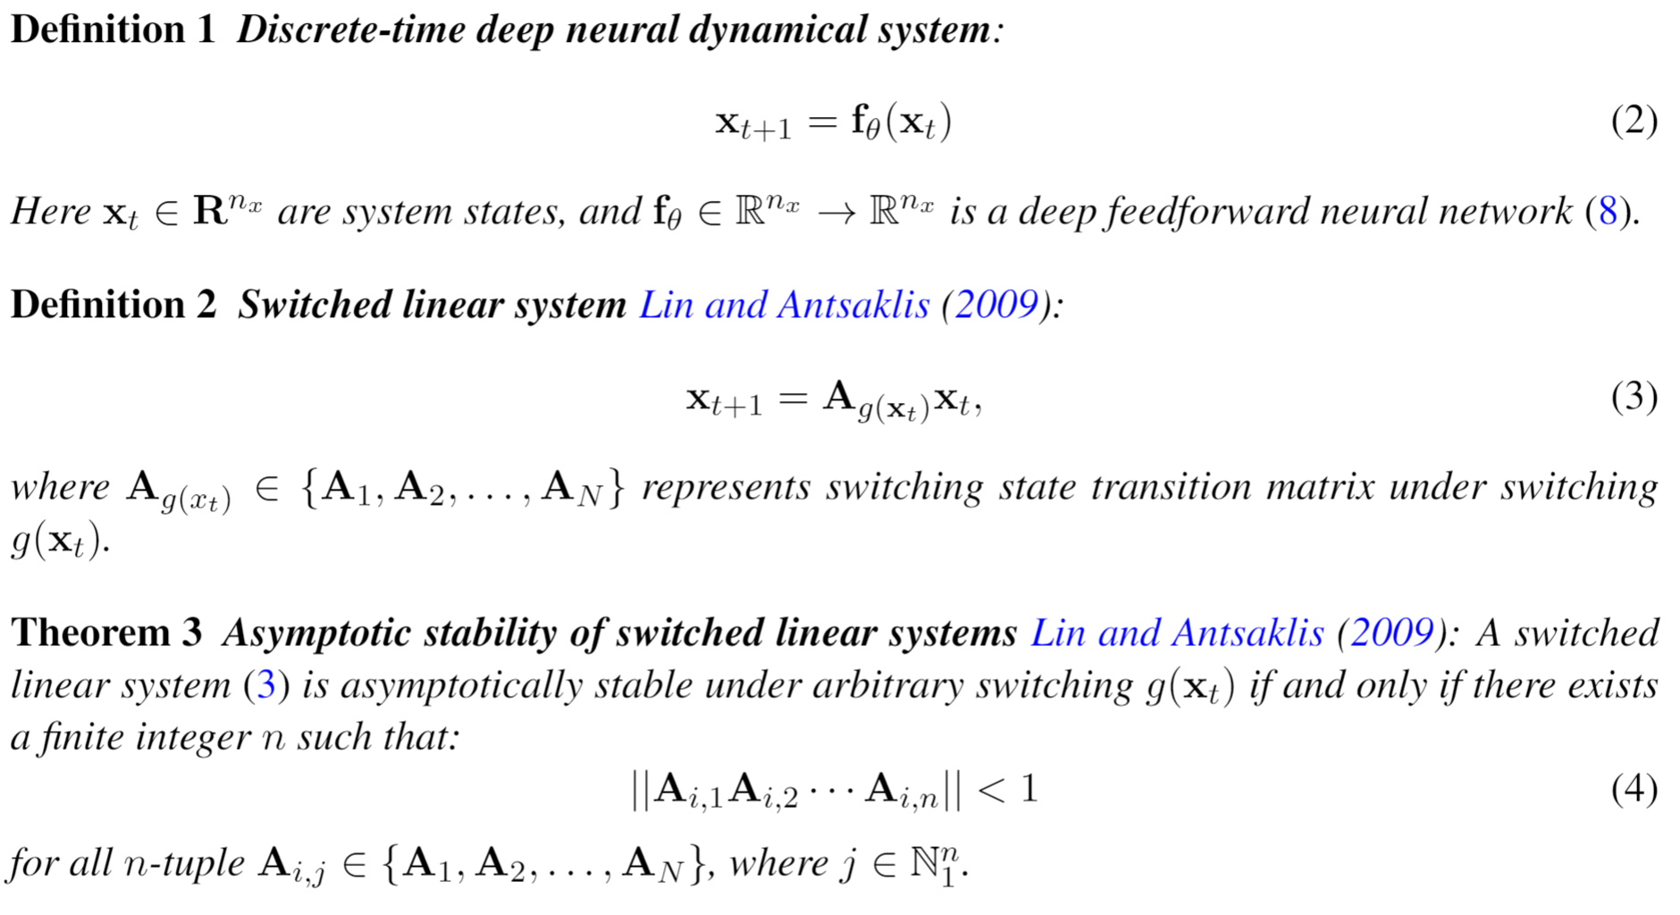
Asymptotic Stability of Switched Linear Systems
H. Lin and P. J. Antsaklis, "Stability and Stabilizability of Switched Linear Systems: A Survey of Recent Results," in IEEE Transactions on Automatic Control, vol. 54, no. 2, pp. 308-322, Feb. 2009, doi: 10.1109/TAC.2008.2012009.
Notes:
The presentation I’m giving today is for a data-driven method for dynamics modeling.
We should care about this because people interact with and depend on complicated systems all the time.
Greater understanding of these systems can lead to outcomes which are
More energy efficient
Cost effective
Conducive to human life
Having an accurate model of a system enables scientific discovery,
Can provide critical information to support high stakes decisions in changing environments
Or to provide necessary information for predictive maintenance of high value equipment, avoiding costly and potentially dangerous equipment
Failures.
One of the most common and lucrative uses of systems models are for predictive control in manufacturing and other large scale enterprises.
I’m presenting a method today which bridges benefits of traditional physics-based modeling with more recent data-driven modeling using deep learning
Traditional physics-based modeling works very well and is widely used in many real world applications. However, it can’t always be applied to every situation.
missing information
incomplete awareness of the model state space.
limitations on the available operational data.
For large scale systems, not only are they difficult to model from first principles, it is also not always possible to simulate the system in real time.
Data-driven approaches for systems modeling are an alternative in these situations but can come with their own disadvantages.
Can take a lot of data to train and may behave unpredictably outside the distribution of training data in unobserved regions of the system state space.
In addition, modern neural network approaches don’t typically provide constraints enforcement within physically realizable and operationally safe bounds,

Slide 6
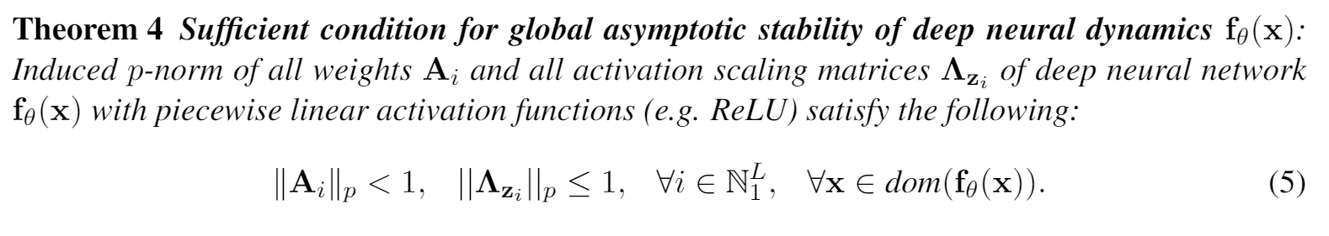
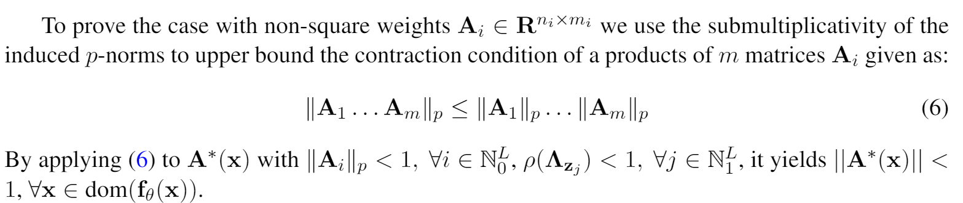
Asymptotic Stability of Deep Neural Dynamics
Let’s assume DNN in the form:
Part of the poof
L. Koci and M. Mateji, “Contractive affine transformations of complex plane and applications,” Facta Universitatis Series Mathematics and Informatics, vol. 21, pp. 65–75, 01 2006.
https://en.wikipedia.org/wiki/Banach_fixed-point_theorem
Notes:
The presentation I’m giving today is for a data-driven method for dynamics modeling.
We should care about this because people interact with and depend on complicated systems all the time.
Greater understanding of these systems can lead to outcomes which are
More energy efficient
Cost effective
Conducive to human life
Having an accurate model of a system enables scientific discovery,
Can provide critical information to support high stakes decisions in changing environments
Or to provide necessary information for predictive maintenance of high value equipment, avoiding costly and potentially dangerous equipment
Failures.
One of the most common and lucrative uses of systems models are for predictive control in manufacturing and other large scale enterprises.
I’m presenting a method today which bridges benefits of traditional physics-based modeling with more recent data-driven modeling using deep learning
Traditional physics-based modeling works very well and is widely used in many real world applications. However, it can’t always be applied to every situation.
missing information
incomplete awareness of the model state space.
limitations on the available operational data.
For large scale systems, not only are they difficult to model from first principles, it is also not always possible to simulate the system in real time.
Data-driven approaches for systems modeling are an alternative in these situations but can come with their own disadvantages.
Can take a lot of data to train and may behave unpredictably outside the distribution of training data in unobserved regions of the system state space.
In addition, modern neural network approaches don’t typically provide constraints enforcement within physically realizable and operationally safe bounds,

Slide 7
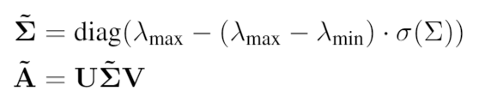
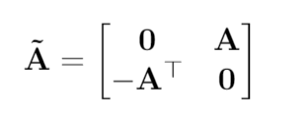
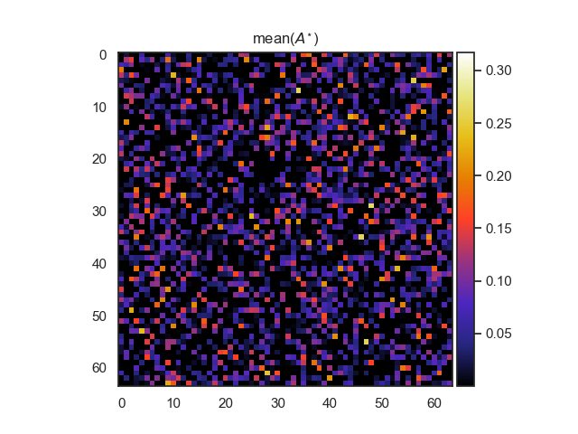
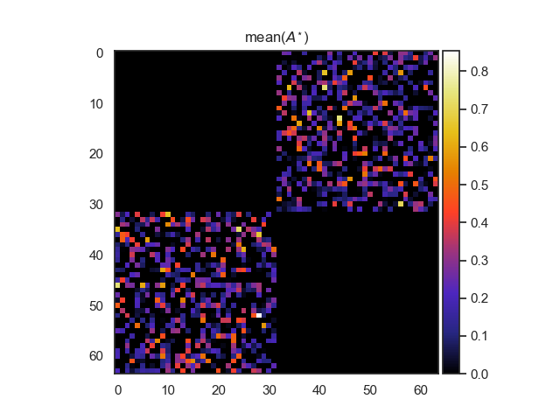
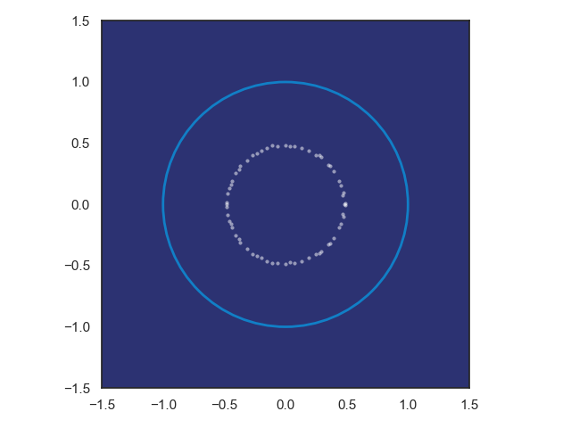
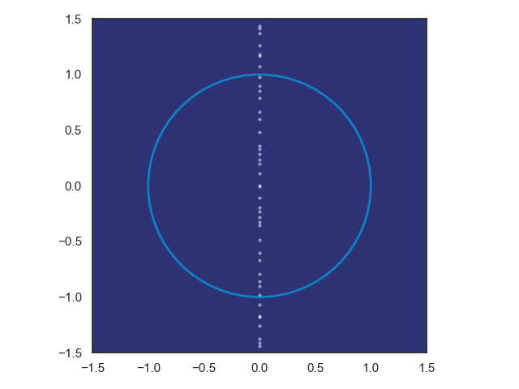
Structured Linear Maps with Eigenvalue Constraints
SVD factorization
Hamiltonian weight
Pytorch implementation: https://github.com/pnnl/slim
[1] Jiong Zhang, et al., Stabilizing Gradients for Deep Neural Networks via Efficient SVD Parameterization, 2018. Eldad Haber and Lars Ruthotto, Stable Architectures for Deep Neural Networks 2017 [2] Jan Drgona, Aaron Tuor, Soumya Vasisht, Elliott Skomski, Draguna Vrabie, Spectral Analysis and Stability of Deep Neural Dynamics, arXiv:2011.13492, 2020

Slide 8
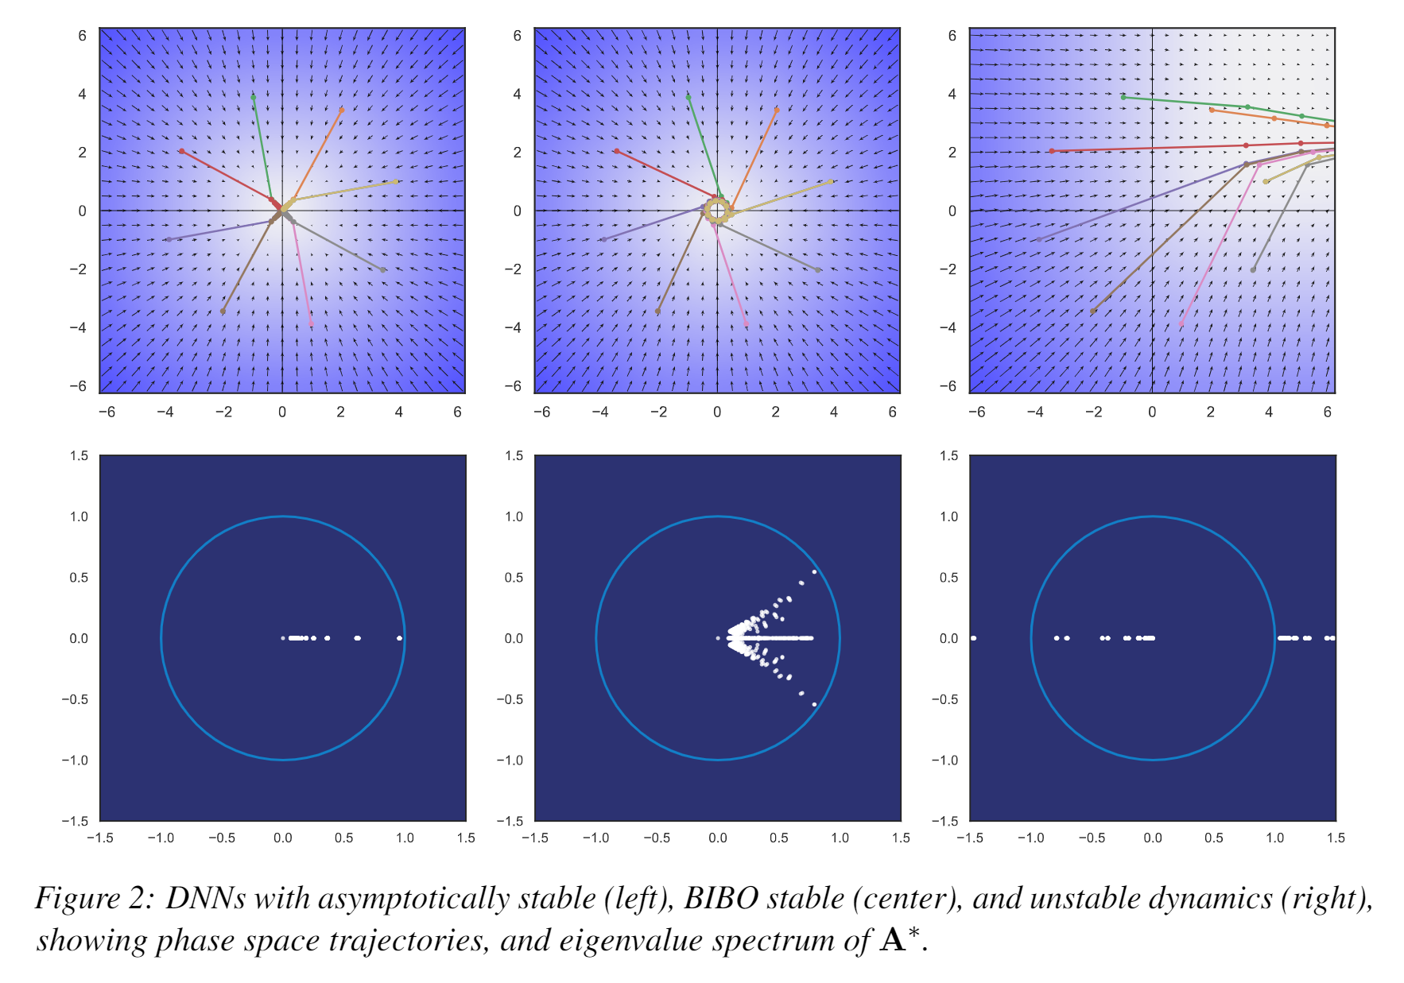
Dynamical Effects of Weights
Jan Drgona, Aaron Tuor, Soumya Vasisht, Elliott Skomski, Draguna Vrabie, Spectral Analysis and Stability of Deep Neural Dynamics, arXiv:2011.13492

Slide 9
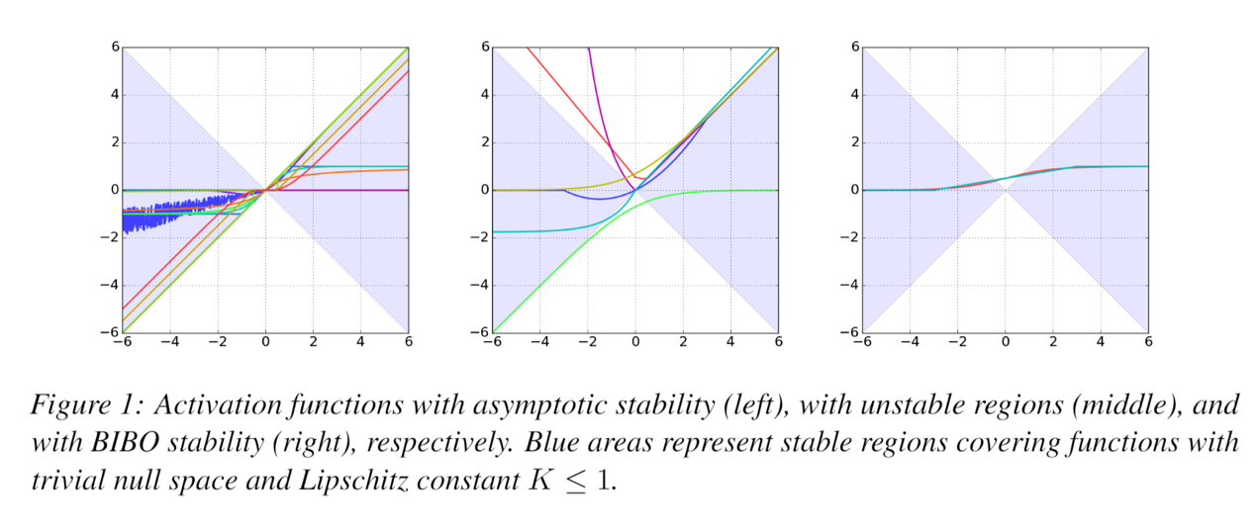
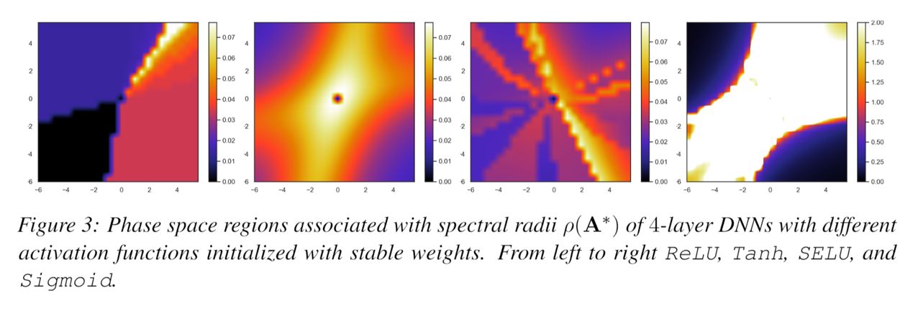
Dynamical Effects of Activation Functions
Jan Drgona, Aaron Tuor, Soumya Vasisht, Elliott Skomski, Draguna Vrabie, Spectral Analysis and Stability of Deep Neural Dynamics, arXiv:2011.13492

Slide 10
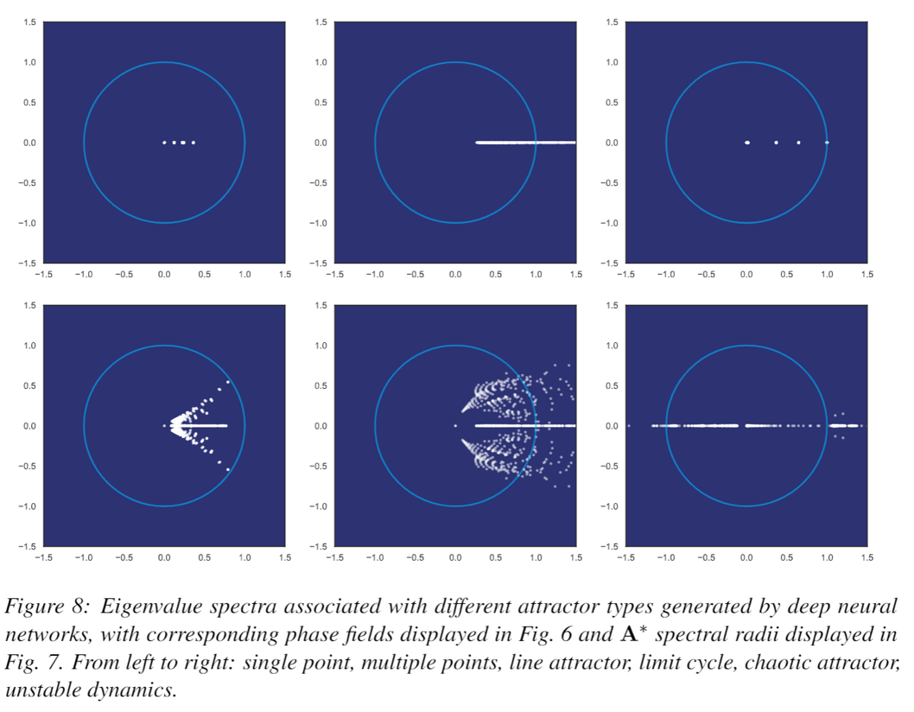
Attractors of Deep Neural Networks
Jan Drgona, Aaron Tuor, Soumya Vasisht, Elliott Skomski, Draguna Vrabie, Spectral Analysis and Stability of Deep Neural Dynamics, arXiv:2011.13492

Slide 11
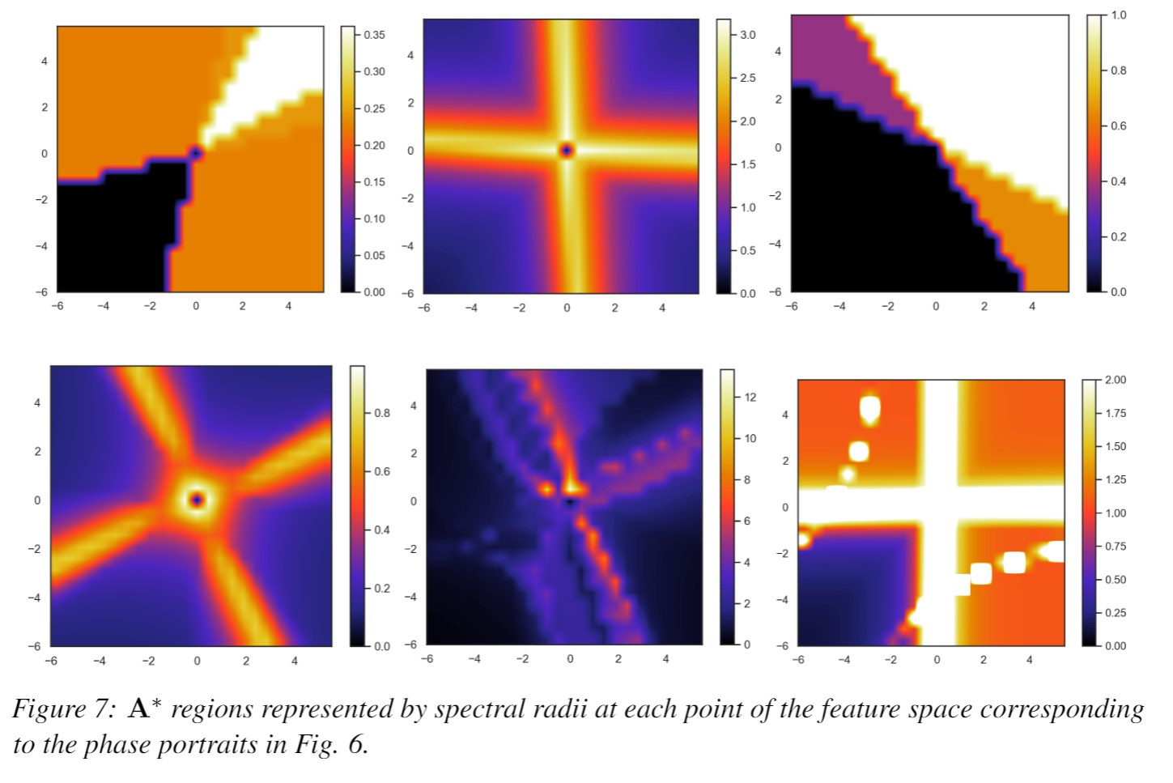
Attractors of Deep Neural Networks
Jan Drgona, Aaron Tuor, Soumya Vasisht, Elliott Skomski, Draguna Vrabie, Spectral Analysis and Stability of Deep Neural Dynamics, arXiv:2011.13492

Slide 12
Conclusion
What
Spectral analysis of neural networks
Why
Performance guarantees
Interpretability
Stable dynamics by design
Applications and research potential
Modeling and control of dynamical systems
Adversarial robustness
New practical methods for mitigating vanishing and exploding gradients
Invertibility of neural networks

Slide 13
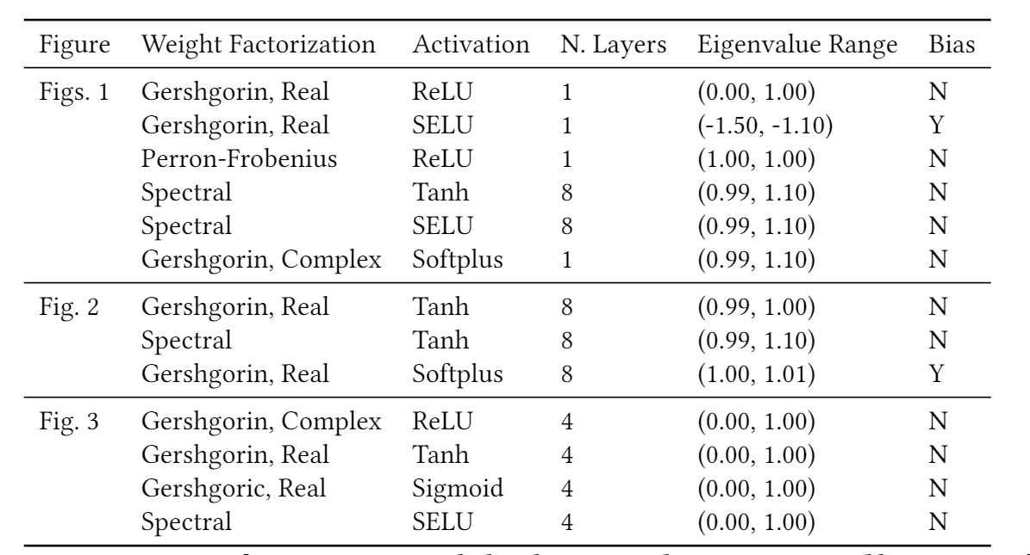
Experiment Design
Jan Drgona, Aaron Tuor, Soumya Vasisht, Elliott Skomski, Draguna Vrabie, Spectral Analysis and Stability of Deep Neural Dynamics, arXiv:2011.13492

Slide 14
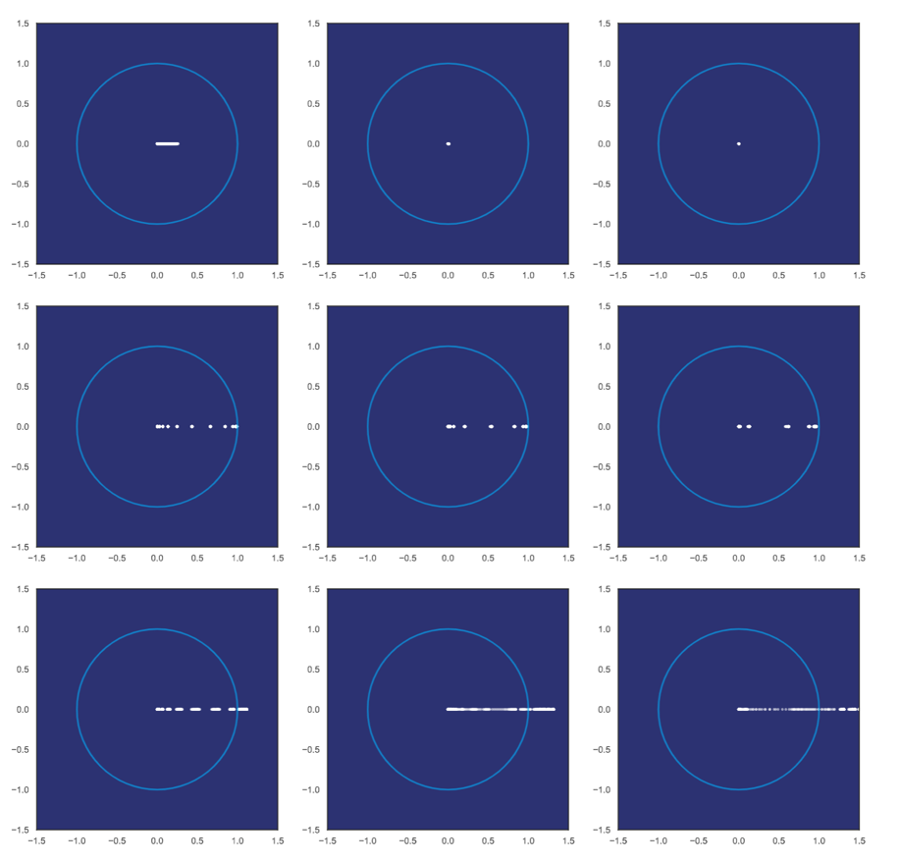
Dynamical Effects of Network Depth
Exponentially stable layers
imply vanishing gradient problem
Network with energy conversion prevents gradient problems
Unstable layers imply exploding gradient problem
Jan Drgona, Aaron Tuor, Soumya Vasisht, Elliott Skomski, Draguna Vrabie, Spectral Analysis and Stability of Deep Neural Dynamics, arXiv:2011.13492

Slide 15
Literature on Stability of Deep Neural Networks
Architecture design
Eldad Haber and Lars Ruthotto, Stable Architectures for Deep Neural Networks 2017.
Sam Greydanus, et al., Hamiltonian Neural Networks, 2019.
Miles Cranmer, et al., Lagrangian Neural Networks, 2020.
Second Lyapunov stability condition
S. M. Richards, et al., The Lyapunov Neural Network: Adaptive Stability Certification for Safe Learning of Dynamic Systems, 2018.
Gaurav Manek, and Zico Kolter, Learning Stable Deep Dynamics Models, 2019.
Ya-Chien Chang, et al., Neural Lyapunov Control, 2019.
Spectral constraints and weight regularizations
Jiong Zhang, et al., Stabilizing Gradients for Deep Neural Networks via Efficient SVD Parameterization, 2018.
Shaowu Pan, Karthik Duraisamy, Long-time predictive modeling of nonlinear dynamical systems using neural networks, 2018.
Eldad Haber, et al., IMEXnet: A Forward Stable Deep Neural Network. 2019
A. Tuor, J. Drgona, D. Vrabie, Constrained Neural Ordinary Differential Equations with Stability Guarantees, 2020.

